Slide 1
BOOSTING TECHNIQUE
Adaboost
Xgboost
lgboost

Slide 2
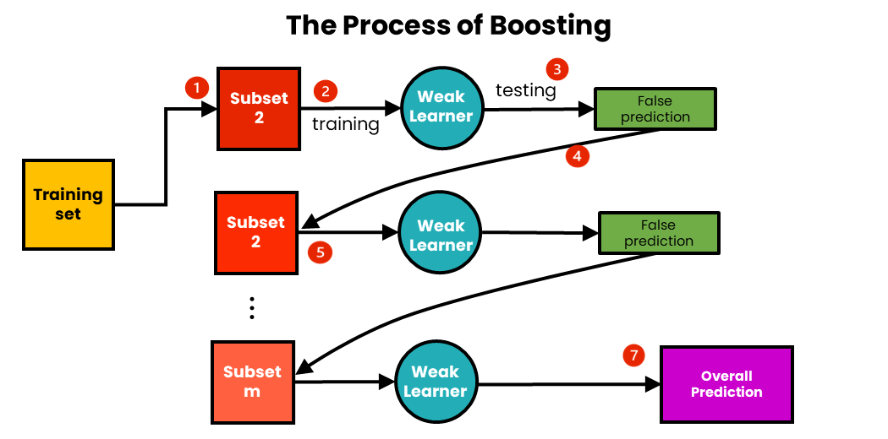
boosting
It combines set of weak learners into strong learners to minimize the training errors
Random sample of data selected fitted to the model and trained sequentially
Each model tries to compensate for the weakness of it’s predecessor

Slide 3
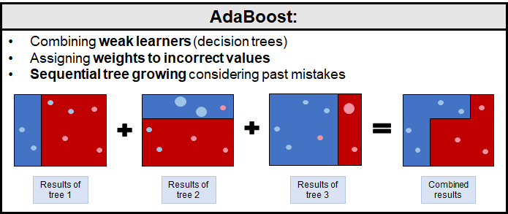
adaboost
The most common estimator used in Adaboost is decision tree with single level
Which means decision tree with one split called Stump
STUMP
LEAF

Slide 4
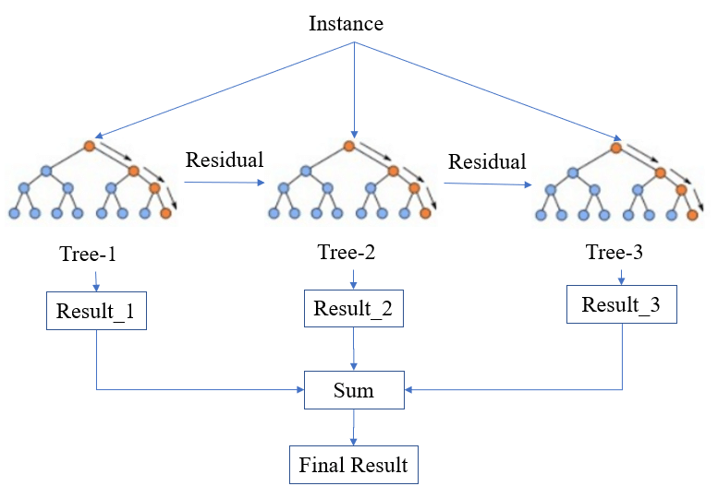
XGBOOST
It’s get trained based on residuals
It then iteratively builds additional models, each one attempting to correct the mistakes of the previous models.
In each iteration, It calculates the gradient of the loss function with respect to the current model's prediction and fits a new decision tree to minimize the loss.
Regularization: To prevent overfitting, including shrinkage and pruning

Slide 5
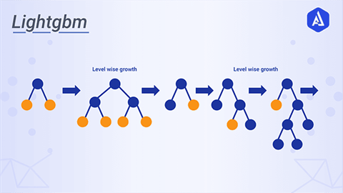
lgboost
LightGBM is a gradient boosting framework that utilizes decision trees as weak learners and is designed to handle large-scale datasets efficiently.
The training process employs techniques such as Gradient-Based One-Side Sampling (GOSS) that optimize the selection of informative data instances for building trees, reducing overfitting.
Overall, LightGBM regression is a powerful tool for accurate prediction of continuous numerical values.

